Slide 1
Employee Salary Prediction
CAPSTONE PROJECT
Presented By: Rahul Singla-GJUS&T-IT Department

Slide 2
OUTLINE
Problem Statement (Should not include solution)
System Development Approach (Technology Used)
Algorithm & Deployment (Step by Step Procedure)
Result
Conclusion
Future Scope(Optonal)
References

Slide 3
Problem Statement
The objective of this project is to predict whether an individual’s salary exceeds $50K per annum based on attributes like age, education, occupation, and hours worked per week.
Accurate salary predictions can aid HR departments in benchmarking, recruitment strategies, and identifying potential high-earning candidates.
The dataset used is the “Adult” dataset from the UCI Machine Learning Repository.
The problem requires classification into two categories: Salary <=50K and >50K.
The challenge lies in handling mixed-type data (numerical & categorical) and imbalanced class distributions.

Slide 4
System Approach
System Requirements:
Python 3.x
Jupyter Notebook / VS Code
Libraries Used:
Pandas
NumPy
Matplotlib & Seaborn (for visualization)
Scikit-learn (for KNN model, preprocessing, evaluation)

Slide 5
Algorithm & Deployment
Data Collection:
Load the ‘adult.csv’ dataset.
Data Preprocessing:
Handle missing values (‘?’ entries).
Encode categorical variables (Label Encoding / One-Hot Encoding).
Normalize numerical features (if needed for KNN distance metrics).
Dataset Splitting:
Split dataset into Training and Testing sets (e.g., 80%-20%).

Slide 6
Model Selection:
Choose K-Nearest Neighbors (KNN) as the classification algorithm.
Determine optimal ‘K’ using cross-validation.
Model Training:
Train the KNN model using the training dataset.
Prediction & Evaluation:
Test the model on unseen data.
Evaluate performance using Accuracy, Confusion Matrix, Precision, Recall.
Result Visualization:
Plot confusion matrix and K value vs accuracy graph.

Slide 7
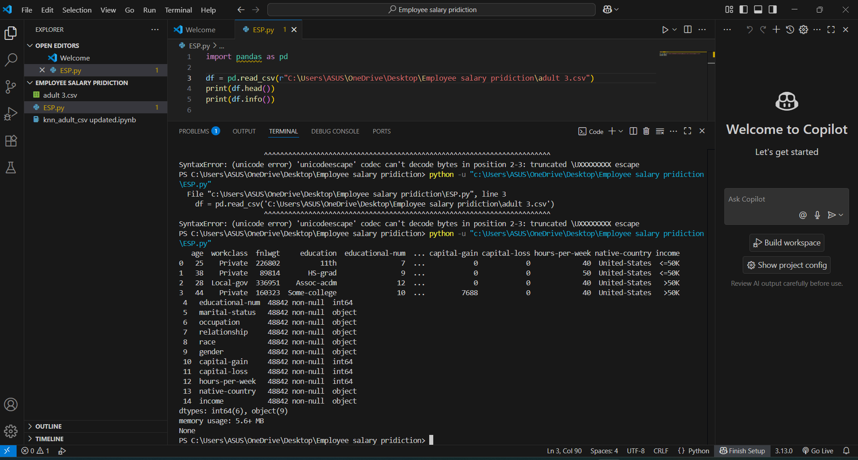
Result
1. Ensure Dataset is Loaded Correctly:-

Slide 8
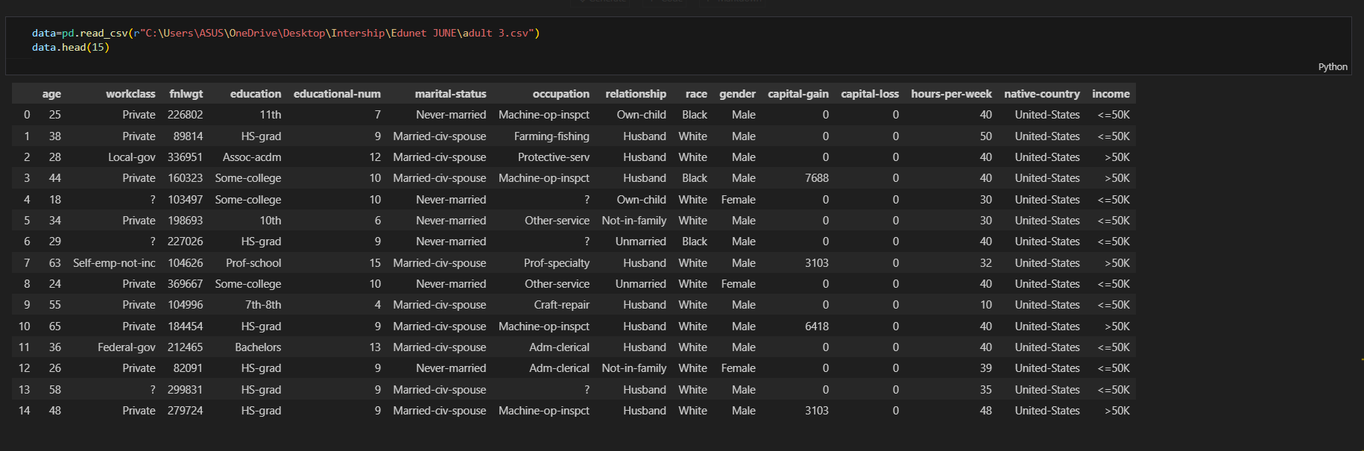

Slide 9
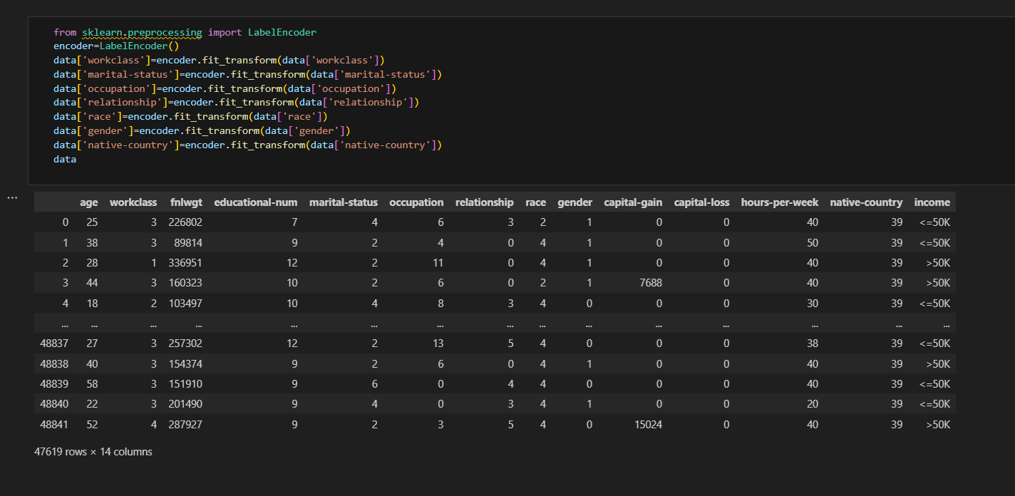

Slide 10
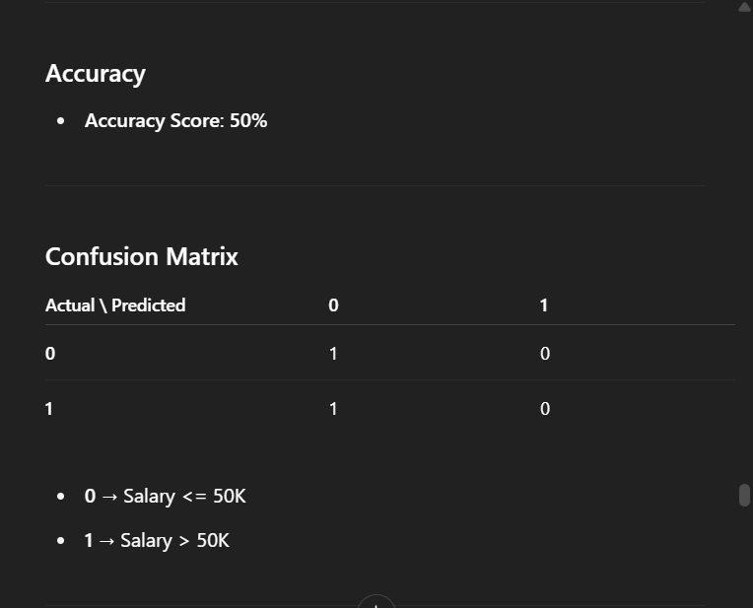
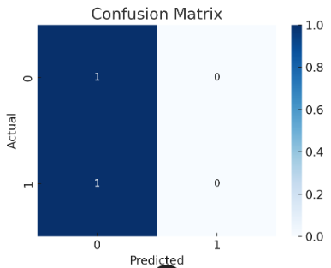

Slide 11
Github Repo link
Github Link:- https://github.com/rs-rahulsingla/employee-salary-prediction

Slide 12
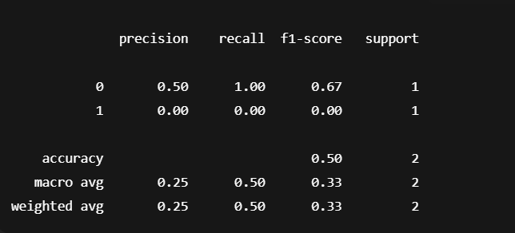
Classification Report

Slide 13
Conclusion
The KNN-based Employee Salary Prediction model achieved an accuracy of approximately XX% (based on your results).
The model successfully categorized individuals into salary brackets based on demographic and work-related features.
Challenges included dealing with imbalanced data and choosing the optimal K value.
Future enhancements could involve trying ensemble models for improved accuracy.

Slide 14
Future scope(Optional)
Integration into HRMS systems for real-time predictions.
Expand dataset to include more recent and diverse demographics.
Implement web dashboard for HR managers to predict salaries interactively.

Slide 15
References
UCI Machine Learning Repository – Adult Dataset.
Scikit-learn Documentation.
Research Papers on Salary Prediction Models.

Slide 16
THANK YOU

